Slide 1

Topic- Scatter plots
EQ- How is the relationship between two variables identified?

Slide 2
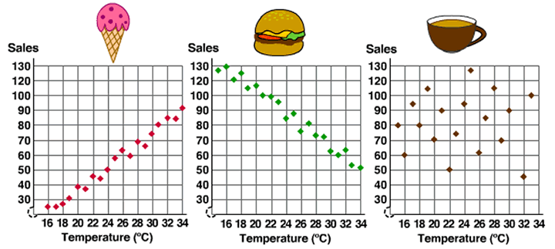
Introduction to scatter plots
A scatter plot displays the relationship between two variables on an X and Y axis.
This relationship is called the correlation.
Scatter plots may compare a dependent and independent variable.
Scatter plots can display a very large dataset.

Slide 3
Independent (IV) and Dependent Variables (DV)
It can be tricky to remember which variable is which:
(Independent variable) causes a change in (Dependent Variable) and it isn't possible that (Dependent Variable) could cause a change in (Independent Variable).
Additionally:
The independent variable is what is being changed.
The dependent variable is what is being measured.
1. Identify the independent and dependent variable in the scatterplots below.

Slide 4
Creating scatter plots
If the data being compared contains an independent variable, then that will go on the x-axis.
Independent variable = x-axis
Therefore… the dependent variable will be placed on the y-axis
Dependent variable = y-axis

Slide 5
Identify the IV and DV of the following statements:
In a study to determine whether how long a student sleeps affects test scores.
You want to compare brands of paper towels, to see which holds the most liquid.
What is the effect of diet and regular soda on blood sugar levels?
How does phone use before bedtime affect sleep?

Slide 6
LHS- Make a scatterplot of the following dataset.
X | 30 | 35 | 40 | 45 | 50 | 55 | 60 | 65 | 70 | 75
Y | 5 | 3.5 | 4 | 6.5 | 7 | 7.5 | 6 | 6.5 | 7 | 9.5
Hint- start from zero on both axes.
Identify the maximum number for each variable.
Decide what interval to increase by on each axis (e.g. 2s and 10s)

Slide 7
Using scatterplots to make predictions
1. What is the correlation between temperature and the sales of items from a deli?
Ice-cream:
Burger:
Coffee:
2. What time of year would you expect each item to have the most sales?
3. If the business wanted to make more money, when should they increase the price of each item?

Slide 8
LHS- Dwyer 10 Textbook
Read page 246.
Complete questions on page 247.

Slide 9
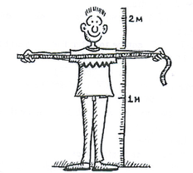
Extension/Alternative Activity
Measure your height and arm span
Notes:
Drawing a scatterplot as a class.
Draw up a set of axes on the whiteboard.
Show students how to plot the point on their using yourself as an Example (or Mr Morgan Height and arm span both 200cm)
When they measure their height and arm span they will then plot their data point on the scatterplot

